Slide 1
Computer ARCHITECTURE (CA)
Course Instructor
Hira beenish
Department of Computer Science

Slide 2

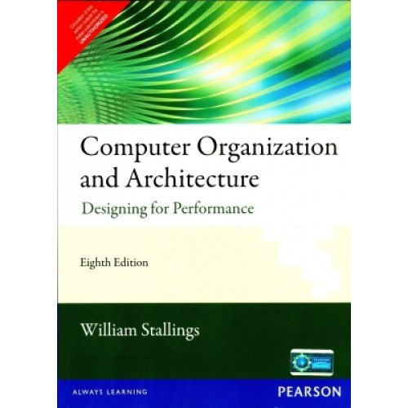
Recommended Books
Computer Systems Architecture, 3rd Edition
By M.Morris Mano; Prentice Hall International
Computer Organization and Architecture Designing For Performance By William Stallings

Slide 3
Chapters Included
1. Digital logic circuits
2. Digital components
3. Data Representation
4. Basic Computer Organization & Design
5. Central processing unit
6.Pilpeline & vector processing
7. Computer arithmetic
8. I/O & O/P organization
9. Memory management
10. Multiprocessors

Slide 4
Chapter#4 Pipeline & vector processing

Slide 5
Contents
Parallel Processing

Slide 6
Parallel Processing
Simultaneous data processing tasks for the purpose of increasing the computational speed
Instead of processing each instruction sequentially as in a conventional computer, parallel processing perform concurrent data processing to achieve faster execution time, For example
While an instruction is being executed in the ALU, the next instruction can be read from memory
The system may have two or more ALUs, furthermore the system may have two or more processors operating concurrently
The purpose of parallel processing is to speed up the computer processing capability

Slide 7
Parallelism in Uniprocessor Systems
A uniprocessor (one CPU) system can perform two or more tasks simultaneously.
The tasks are not related to each other. So, a system that processes two different instructions simultaneously could be considered to perform parallel processing

Slide 8
Vector Arithmetic unit
Vector Arithmetic unit is used to perform different arithmetic operations in parallel.
A vector arithmetic unit contains multiple functional units. Some perform addition, others subtraction, and others perform different functions.

Slide 9
Parallelism in Multiprocessor Systems
Parallel processing systems achieve parallelism by having more than one processor performing tasks simultaneously.
Since multiprocessor systems are more complicated than uniprocessor systems, there are many different ways to organize the processors and memory,
So a Researcher, Michael J. Flynn proposed a classification based on the flow of instructions and data within the computer called Flynn’s classification

Slide 10
Flynn’s Classification
It is based on instruction and data processing.
A computer is classified by whether it processes a single instruction at a time or multiple instructions simultaneously, and whether it operates on one or multiple data sets.

Slide 11
Categories of Flynn’s Classification
SISD: Single instruction with single data
SIMD: Single instruction with multiple data
MISD: Multiple instruction with single data
MIMD: Multiple instruction with multiple data

Slide 12
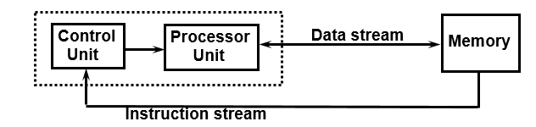
Single Instruction Single Data (SISD)
SISD machines executes a single instruction on individual data values using a single processor.
One control unit, one processor unit, and one memory unit

Slide 13
(SIMD) Single Instruction Multiple Data
As its name implies, an SIMD machine executes a single instruction on multiple data values simultaneously using many processors.
Since there is only one instruction, each processor does not have to fetch and decode each instruction.
Instead a single control unit handles this task for all processors within the SIMD computer

Slide 14
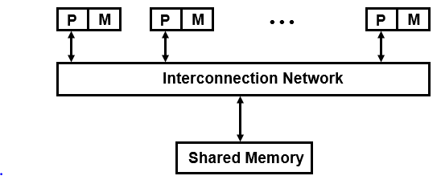
(MISD) Multiple Instruction Single Data
This classification is not practical to implement. So, no significant MISD computers have ever been built
Execution of multiple instructions on multiple data
Shared memory multiprocessors
Message-passing multi computers
(multicomputer system)

Slide 15
MIMD) Multiple Instruction Multiple Data
Systems referred to as multiprocessors or multi computers are usually MIMD.
It may execute multiple instructions simultaneously, unlike SIMD. So, each processor must include its own control unit.
MIMD machines are well suited for general purpose use.

Slide 16
System Topologies
The topology of a multiprocessor system refers to the pattern of connections between its processors.
Various factors, typically involving a cost-performance tradeoff, determine which topology a computer designer will select for a multiprocessor system
Examples of Topology (pattern of connections between processors)
Shared Bus Topology
Ring Topology
Tree Topology
Mesh Topology
Hypercube Topology
Completely connected Topology

Slide 17
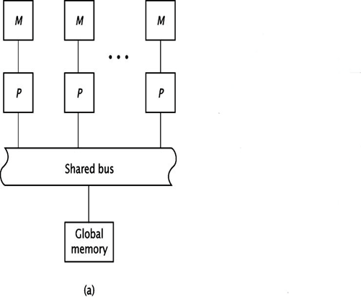
Shared Bus Topology
In this topology, processors communicate with each other exclusively through this bus. However, the bus can only handle only one data transmission at a time. In most shared busses, processors directly communicate with their own local memory.

Slide 18
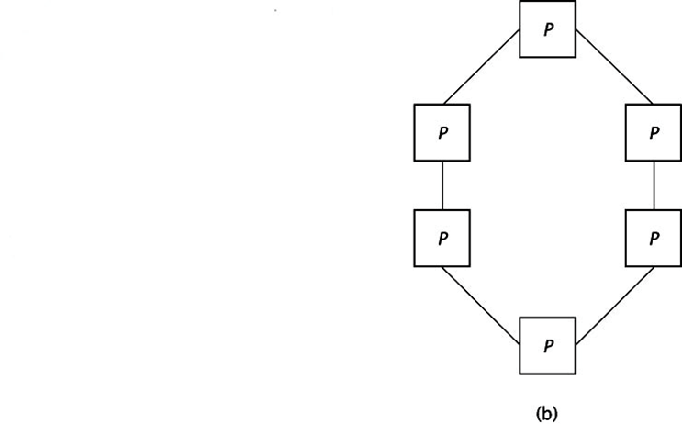
Ring Topology
The ring topology uses direct connections between processors instead of a shared bus. This allows all communication links to be active simultaneously.
Data may have to travel through several processors to reach its destination

Slide 19
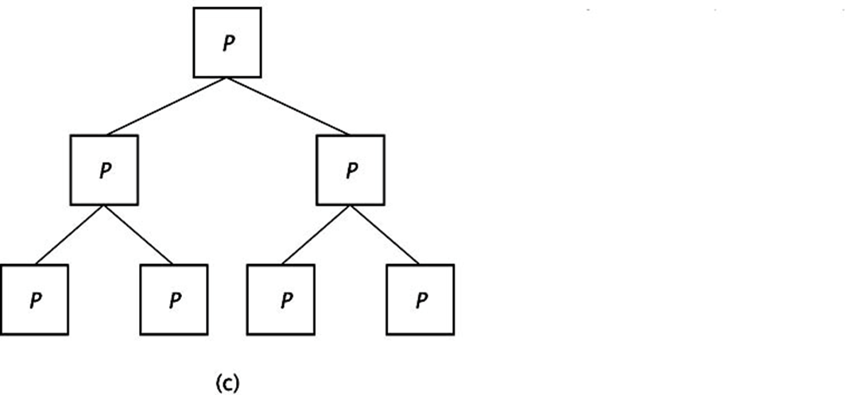
Tree Topology
Like the ring, it uses direct connections between processors; each having three connections. There is only one unique path between any pair of processors

Slide 20
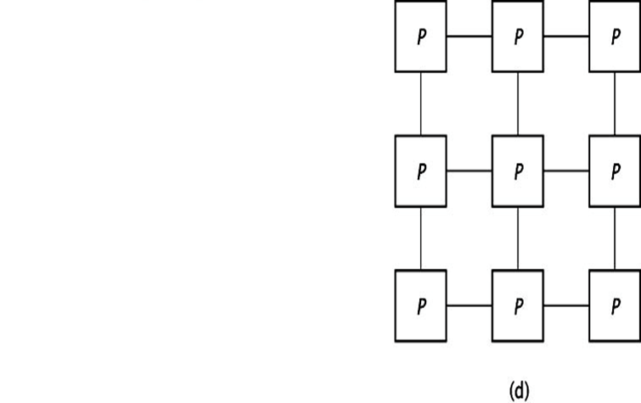
Mesh Topology
In the mesh topology, every processor connects to the processors above and below it, and to its right and left.

Slide 21
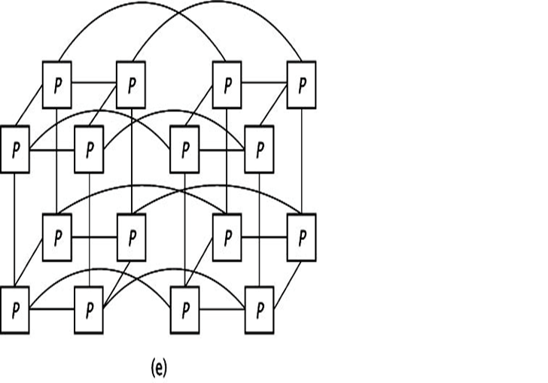
Hypercube Topology
The hypercube is a multidimensional mesh topology. Each processor connects to all other processors whose binary values differ by one bit.

Slide 22
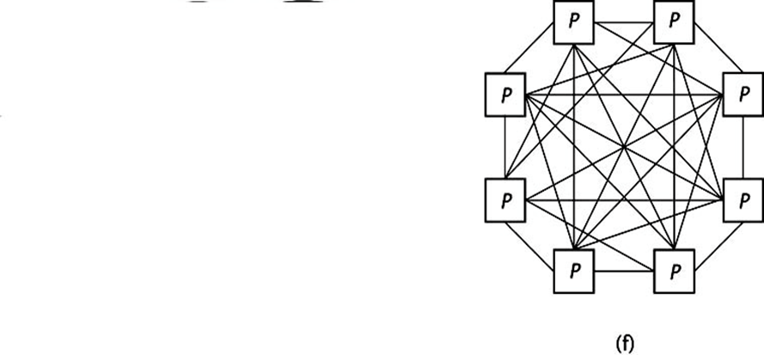
Completely connected Topology
In the most extreme connection scheme, the processors are completely connected. Every processor has (n-1) connections, one to each of the other processors.
This increases the complexity of the processors as the system grows, but offers maximum communication capabilities.

Slide 23
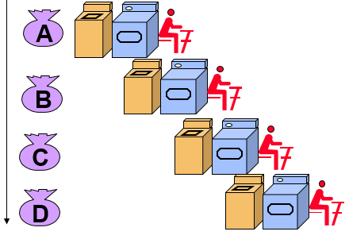
Pipelining
Decomposing a sequential process into sub operations
Each sub process is executed in a special dedicated segment concurrently

Slide 24
INSTRUCTION CYCLE
Pipeline processing can occur also in the instruction stream. An instruction
pipeline reads consecutive instructions from memory while previous
instructions are being executed in other segments.
Six Phases* in an Instruction Cycle
[1] Fetch an instruction from memory
[2] Decode the instruction
[3] Calculate the effective address of the operand
[4] Fetch the operands from memory
[5] Execute the operation
[6] Store the result in the proper place

Slide 25
4-Stage Pipeline
[1] FI: fetch an instruction from memory
[2] DA: decode the instruction and calculate the effective address of the operand
[3] FO: fetch the operand
[4] EX: execute the operation

Slide 26
Pipeline Conflicts
Pipeline Conflicts : 3 major difficulties
1) Resource conflicts: memory access by two segments at the same time. Most of these conflicts can be resolved by using separate instruction and data memories.
2) Data dependency: when an instruction depend on the result of a previous instruction, but this result is not yet available.
Example: an instruction with register indirect mode cannot proceed to fetch the operand if the previous instruction is loading the address into the register.
3) Branch difficulties: branch and other instruction (interrupt, ret, ..) that change the value of PC.

Slide 27
Thank you

